Slide 1

Flex Framework Basics
Globant Tech Updates

Slide 2
Agenda
The Flah platform
Actionscript
What's NOT Flex?
Flex Framework.
Spoiler
Showcase
Questions

Slide 3

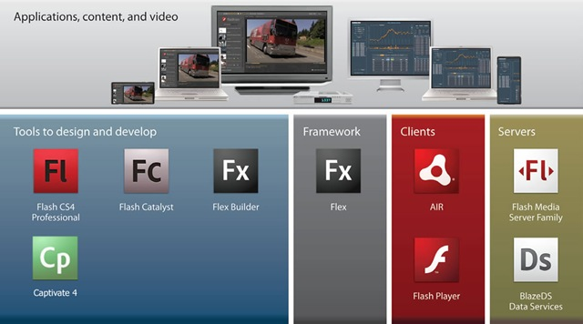
The Flash Platform
Is a stack of web technologies that ease the development of Rich Internet Applications (RIAs)

Slide 4

Actionscript
Two popular versions: AS2 (deprecated) & AS3.
ECMAScript Compliant (Javascript).
Interpreted Langage (AVM1/2).
Compiled language (as bytecode).
Dynamic typing (Also supports static typing).
Object oriented.
Event-Driven.
DOM Compliant.
Multimedia Programming oriented.
Virtual Machines:
  Flash Player
  Air Runtime
  GNU Gnash (open source)

Slide 5
Tip
When you code in Flex you are actually coding in Actionscript

Slide 6



What's NOT Flex ?
Flex is NOT a programming language
Flex is NOT an extension of HTML
Flex is NOT an IDE (Flex Builder was...)
Flex is NOT a library
Flex is NOT a runtime environment
Flex is NOT that thing you think it is
≠

Slide 7

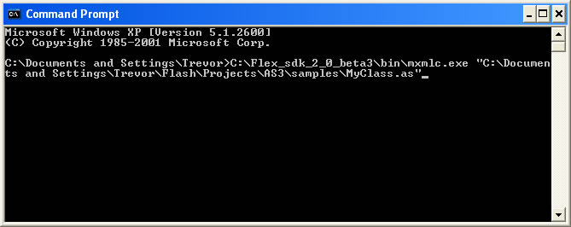
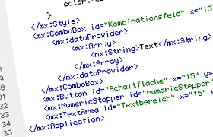
Flex is a Software Development Kit
Flex AS3 Framework
+
=
MXMLC Compiler
+
MXML Language

Slide 8

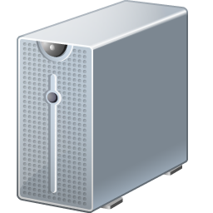








Flex is a Frontend Technology
Transport
XML
JSON
SOAP
REST
AMF
SOCKET
…
Client side
Server side

Slide 9

Flex is
Opensource (ish)
Free
Opensource
MXMLC
Framework
APIs
SWF Format
AS3 Interpreter
IDEs
Runtimes
(depends)
(depends)
(nope)

Slide 10
Tip
Flex makes easier developing Flash applications to web programmers

Slide 11

Spoiler Alert!
Actionscript is like Javascript
MXML is like HTML (but object oriented)
CSS is like … well … CSS
Bruce Willis is dead at the
end of The Sixth Sense

Slide 12
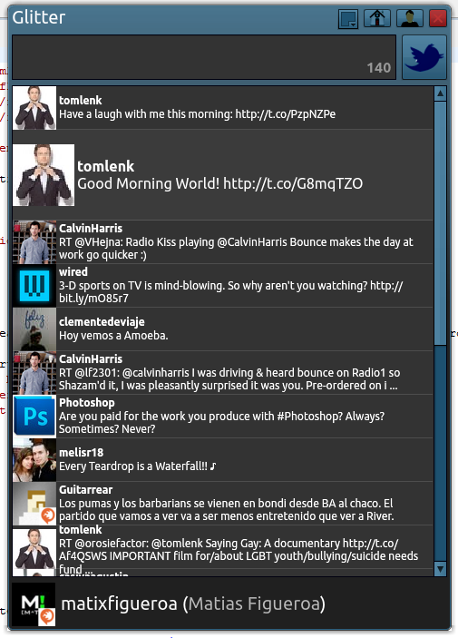
Showcase
Glitter
A (really) simple twitter client made using the Adobe Flex Framework.

Slide 13
Toolkit
Adobe Flash Builder 4.0
http://www.adobe.com/products/flash-builder.html
Flex Framework 4.0
http://opensource.adobe.com/wiki/display/flexsdk/Flex+SDK
Tweetr AS3 Library
http://wiki.swfjunkie.com/tweetr
AS3crypto library
http://code.google.com/p/as3crypto/
($$$)

Slide 14

Check it out!
https://github.com/matix/glitter

Slide 15
Unveil the ”magic” ...
-keep-generated-actionscript

Slide 16
Thanks!
Questions ??
matias.figueroa@globant.com
@matixfigueroa

